Slide 1
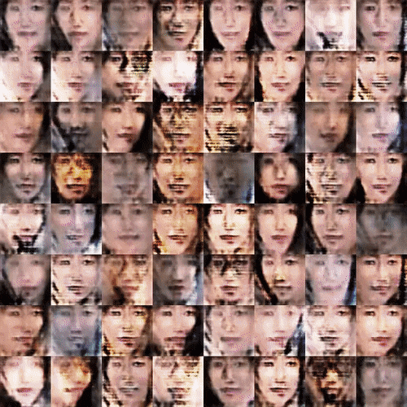
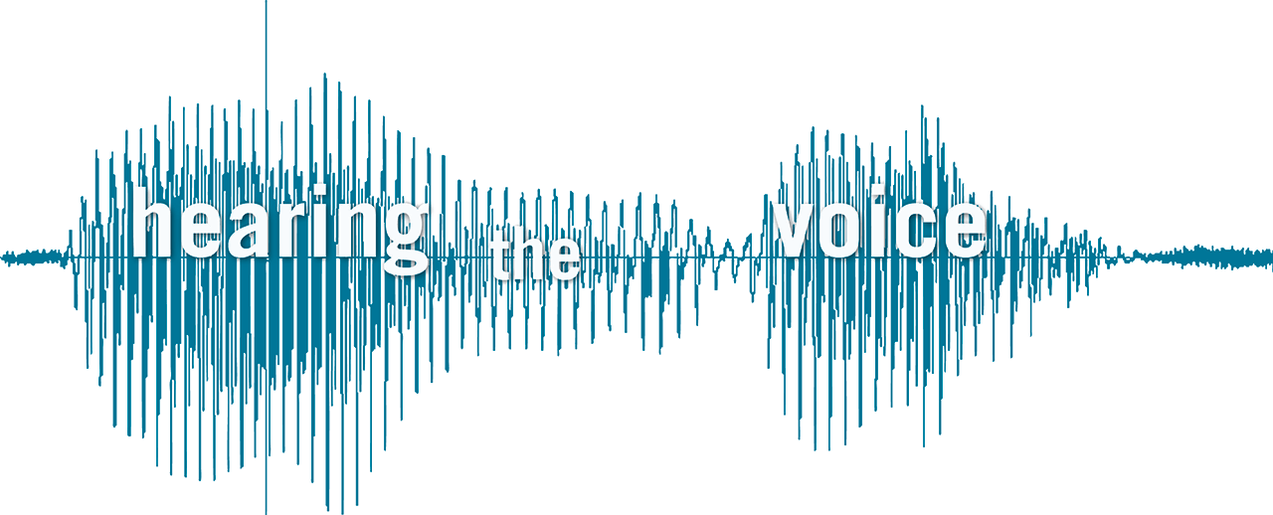

Slide 2
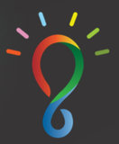
INFINITY
2017-2018
Notes:
Introduce

Slide 3
Voice-Image Synthesiser
Asariri
Notes:
Speak about the project

Slide 4

Notes:
Say something about the Idea

Slide 5
WHAT
WHY
HOW
The Problem
Build a deep learning model that captures the voice fingerprint along with the user auxiliary features like face, posture etc., and use that to synthesis new machine voice given a picture or recreate the auxiliary features given a voice recording.
The Purpose
As of now the use cases are fuzzy, following are few that popped-in our head:
- We might end up with a model which can synthesise a voice for given picture
- Data augmentation: creating new data set from the history of past recordings which are close to real world recordings, which then can be used to train other models
- When above idea gets materialised, it can be wrapped as a fun mobile application to reach the end user, where we can collect more realistic data
- Crime Investigation
The Solution
Collecting Video-Audio data on particular personalities
By combining Tensorflow models like
Wave Net
GANS
Neural Encoders

Slide 6
What does YOUR voice say about you?
Notes:
Speak about Nottingham Trent University

Slide 7
The Problem
At some point of time (mostly pre Facebook era :)) in our lives we had wished to see our close to heart RJs, whose voice had kept as awake in late nights or gave energetic early morning start, isn't?
How about solve that curious with latest technologies and internet data available, to build a deep learning model that can "GUESS" a person facial features based on the voice. Yes exactly that's
what you read! Let us use machines to do the sketching for our dearest Rjs who lives in our visualization. (of course these days they have their own FB pages ;))

Slide 8
The Problem Cont.
Fun part apart, to deal with this challenge we need to be equipped with latest technologies both at Software and Hardware level.
Problem nature might not be directly coupled with any of immediate business values, however if this is taken up, this puts a strong reputation on Imaginea on what kind of complex problems we can deal with.

Slide 9
Our Solution
There are lot of Deep Learning models that works well on Audio and Video data.
Out which we are passionate to go with Wavenet and GANs
GANs
A image generator, which creates a new image by looking/training after 1000s of images
Wavenet:
A paper and alibray published by Google DeepMind, which is a text to voice generator that imitates human voice
Our naive approach at the moment is to study this two different architecture/models from couple of Github repos and adapt it to our idea.

Slide 10
Bottlenecks
The major hurdle at the moment what we think would be
Data collection:
Any available video sources out there, eg.,
- TED talks
- Youtube videos (where only a single person in the video like tutorials)
- Screenshots, voice samples, and possible audio to text data.
- Hardware Requirements
- GPUs

Slide 11
The Target Market
- Data Generator:
- Create new data set from past recordings which imitates the real world data to some degree of certainty
- When above idea gets materialised, it can be wrapped as a fun mobile application to reach the end user, where we can collect more realistic data
- Synthesiser:
- We might end up with a model which can synthesise a voice for
given picture
- In Crime Investigation, we could generate image for a given voice

Slide 12
Similar Problem Solvers
GAN
StackGAN
DeepMind Wavenet

Slide 13
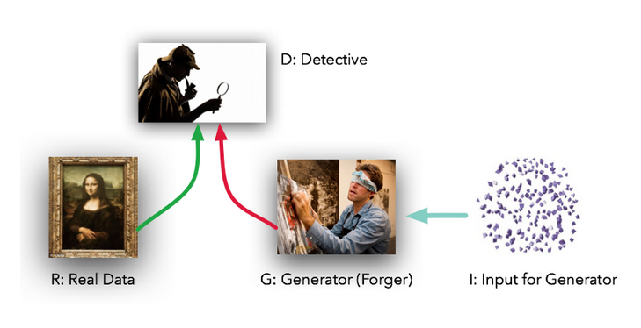
GAN

Slide 14
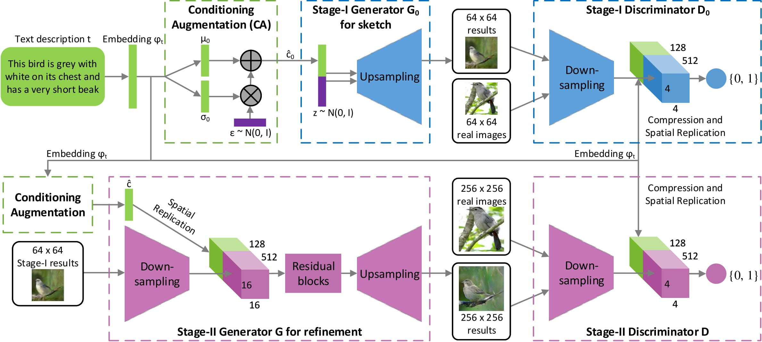

Slide 15
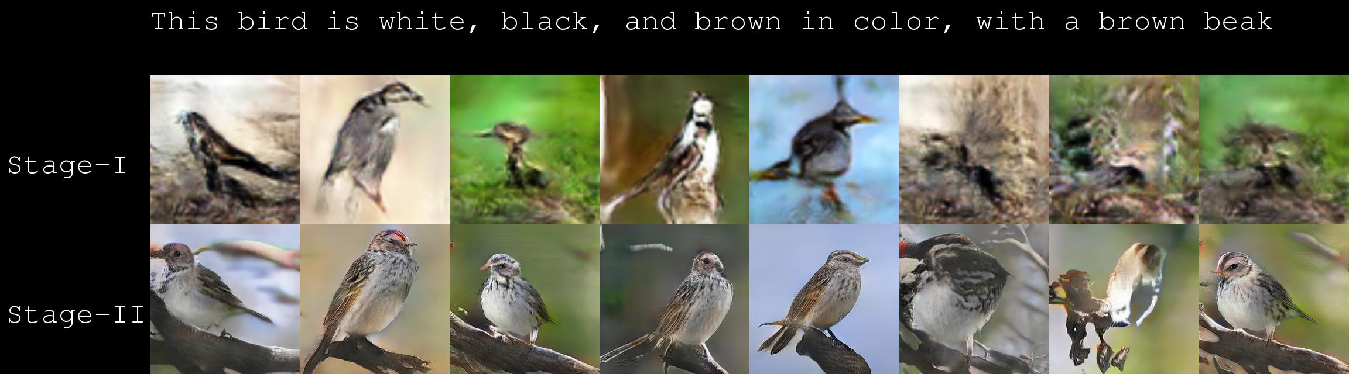
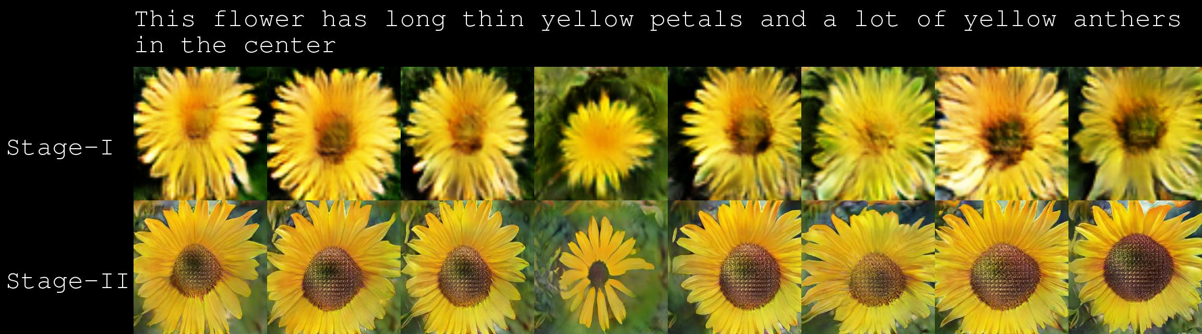

Slide 16
Concept Summary
In short, we would like pursue our R&D initiatives in Data Science team with an end goal, at the same time a fun filled project which can be turned down to be a product as the idea materializes and matures.

